Slide 1
Project 4: Analysis of the 2022 Formula-1 season
By: Gak Roppongi, and Steven Ohms

Slide 2
Introduction
Mercedes F1 team has been dominant for the past 8 years. But after the regulation changed in 2022, they did not do a good job. To analyze what is wrong with this team, we took the data from theOehnrly / fastf1.
According to some of the formula 1 analyst, the result of race is not only because of the team power, but the result is somehow correlated with the engine supplier. Therefore, we hypothesized that the top speed is what is making the biggest difference in the result for this season.
So the problem that we are trying to solve is exactly why the Mercedes team is performing poorly, and what factors are important to performing well.
We used DBSCAN, PCA, data visualization, and statistical analysis. We also filled the missing values via mean filling.
Notes:
Mercedes-AMG F1 team did a great job for the past 8 year from 2014 to 2021. No other team in the formula 1 history was even close to their level of dominance in the championship. However, so far (until the 3rd stage of the championship out of 23 races for the season), mercedes did not win any race, got the podium only once, got knocked out in the qualifying so early several times.
#go through our findings, showing our graphs and explaining them, describe what the colors represent
#end the data portion with the tire reveal
#end with what we would do if we had more time

Slide 3
Legend
Each color represents a different team or engine
PU stands for power unit, and represents different engines used
Each color represents the primary color associated with each team
Mercedes: —-----------Teal/green
Ferrari: —--------------Red
Alpine: —--------------Light Blue
Red Bull Racing: —----Dark Blue
Haas: —----------------White
Aston Martin: —-------Dark Blue/Green
Alpha Tauri: —---------Navy Blue
McLaren: —------------Orange
Alfa Romeo Racing: —-Maroon
Williams: —------------Blue
Notes:
# the values are based off the specific hexadecimal values, provided by the reddit link below

Slide 4
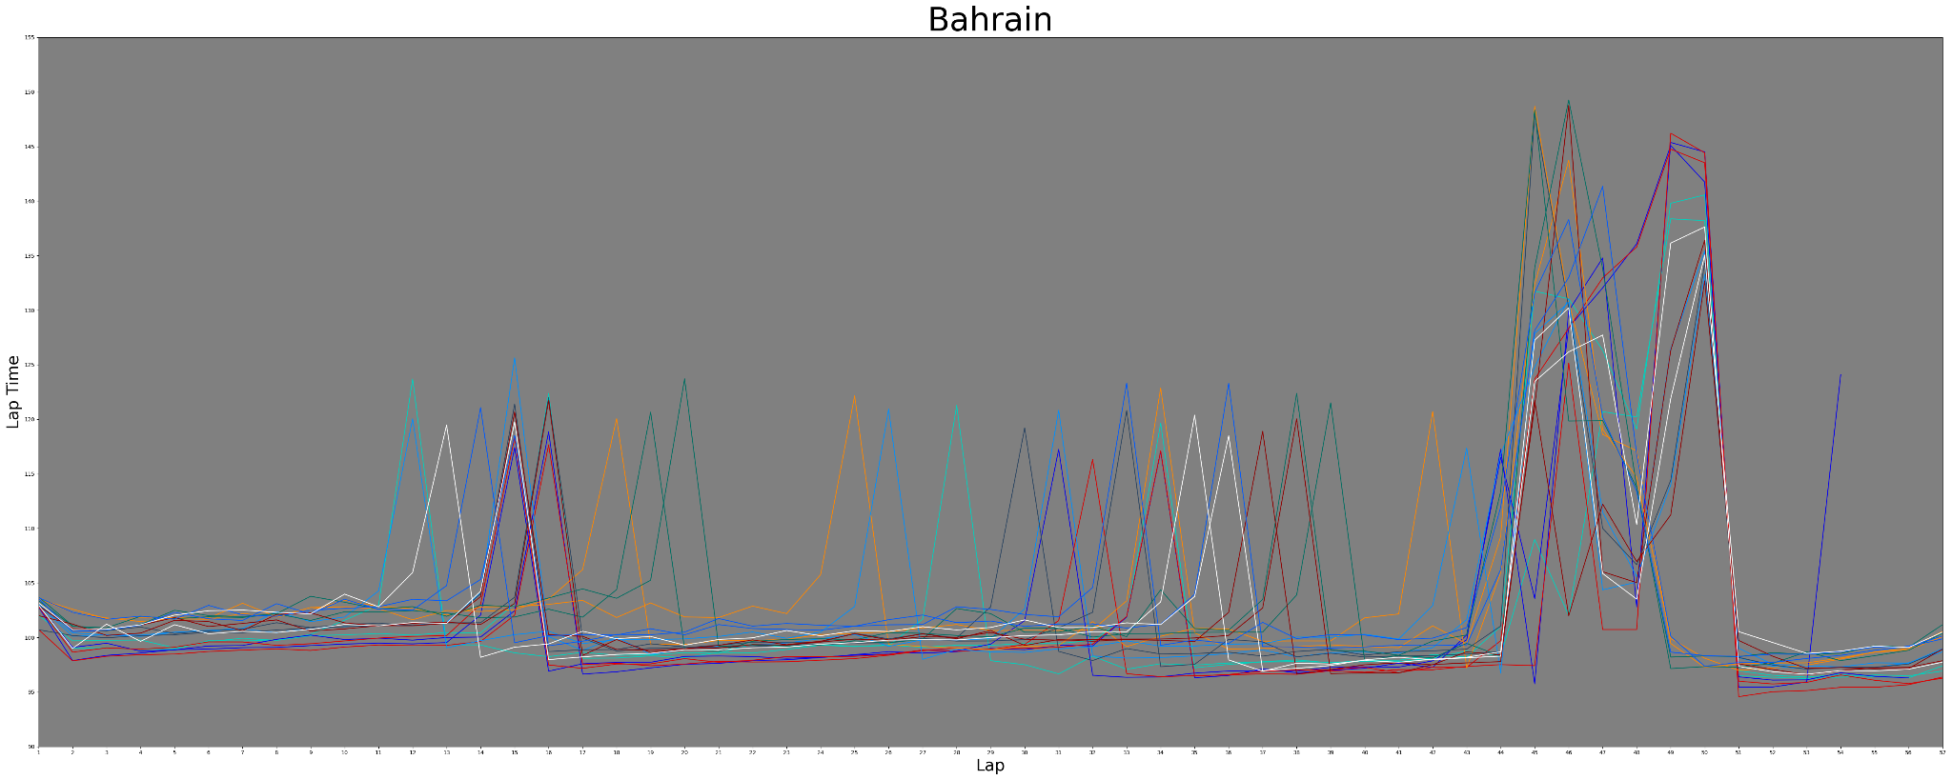
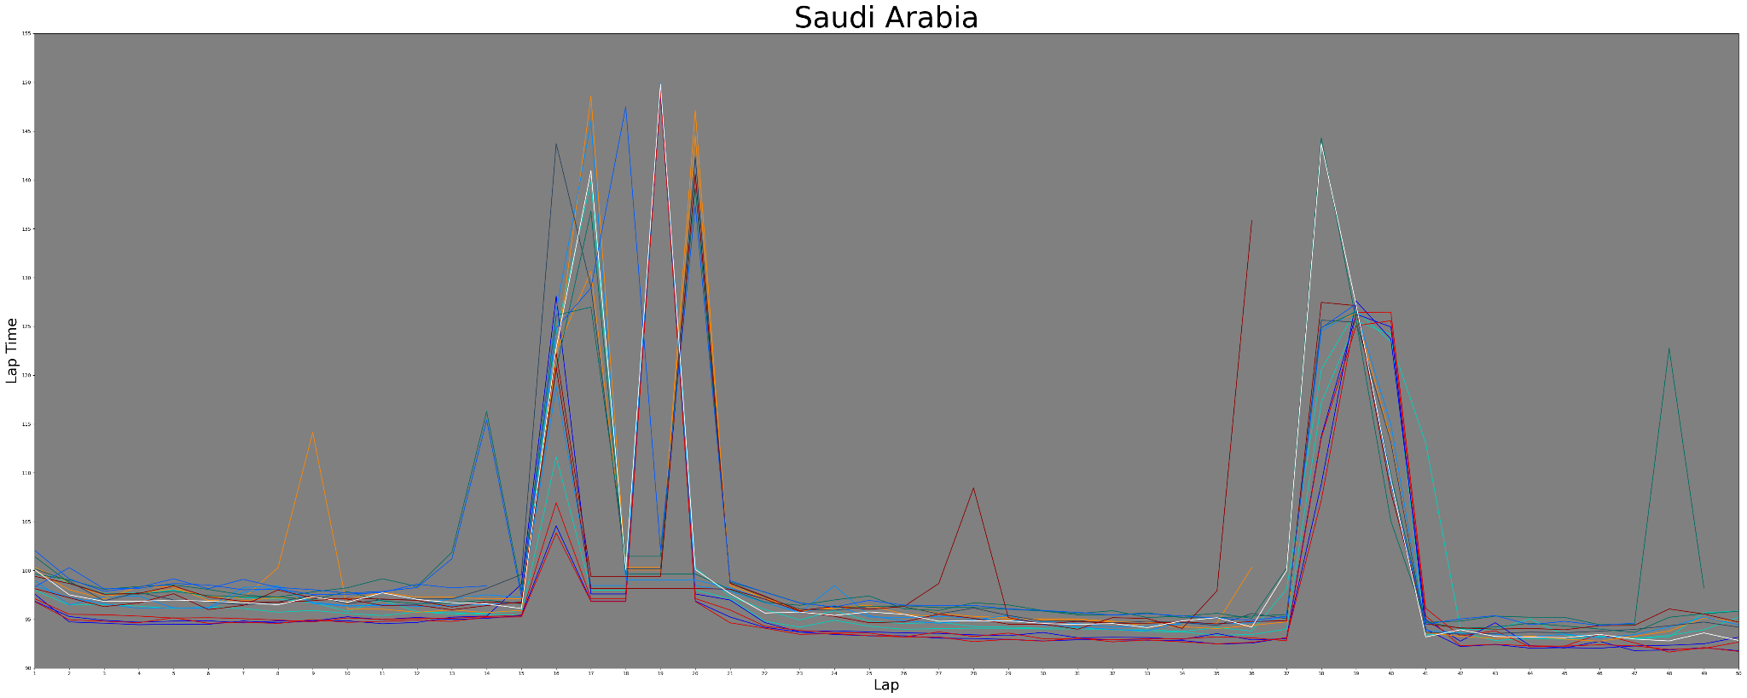
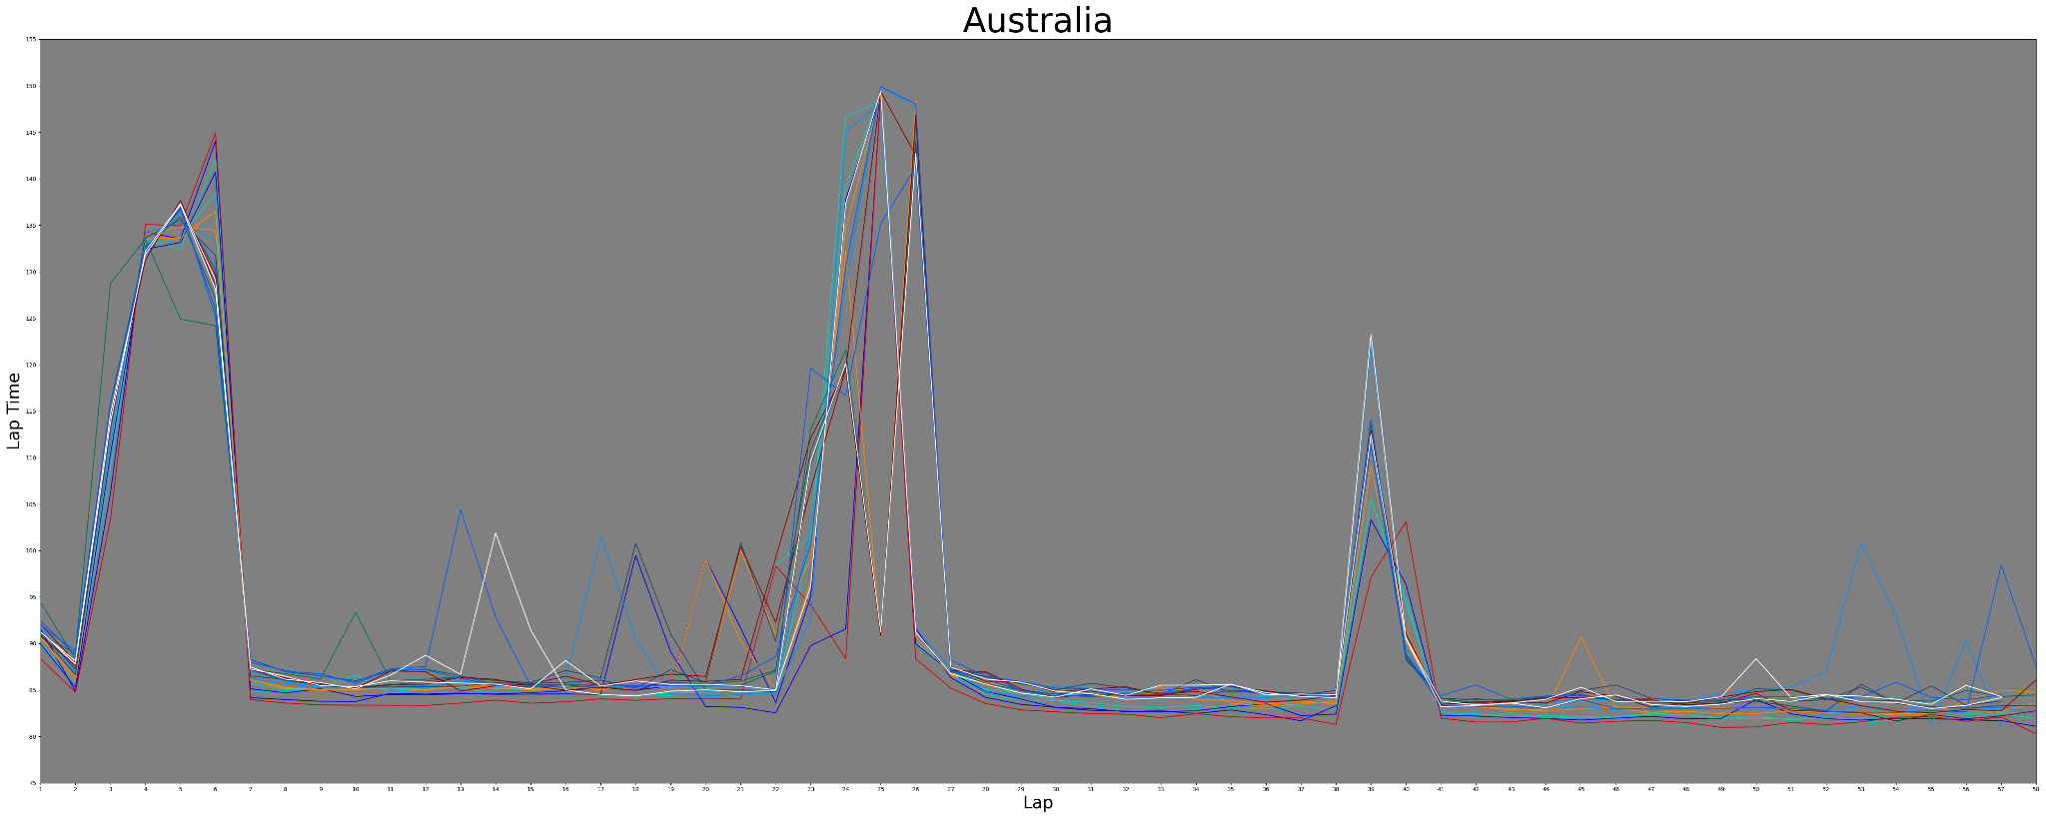

Slide 5
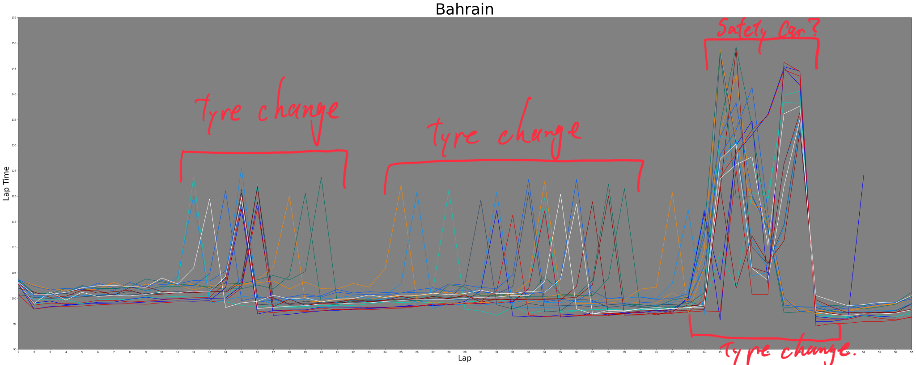
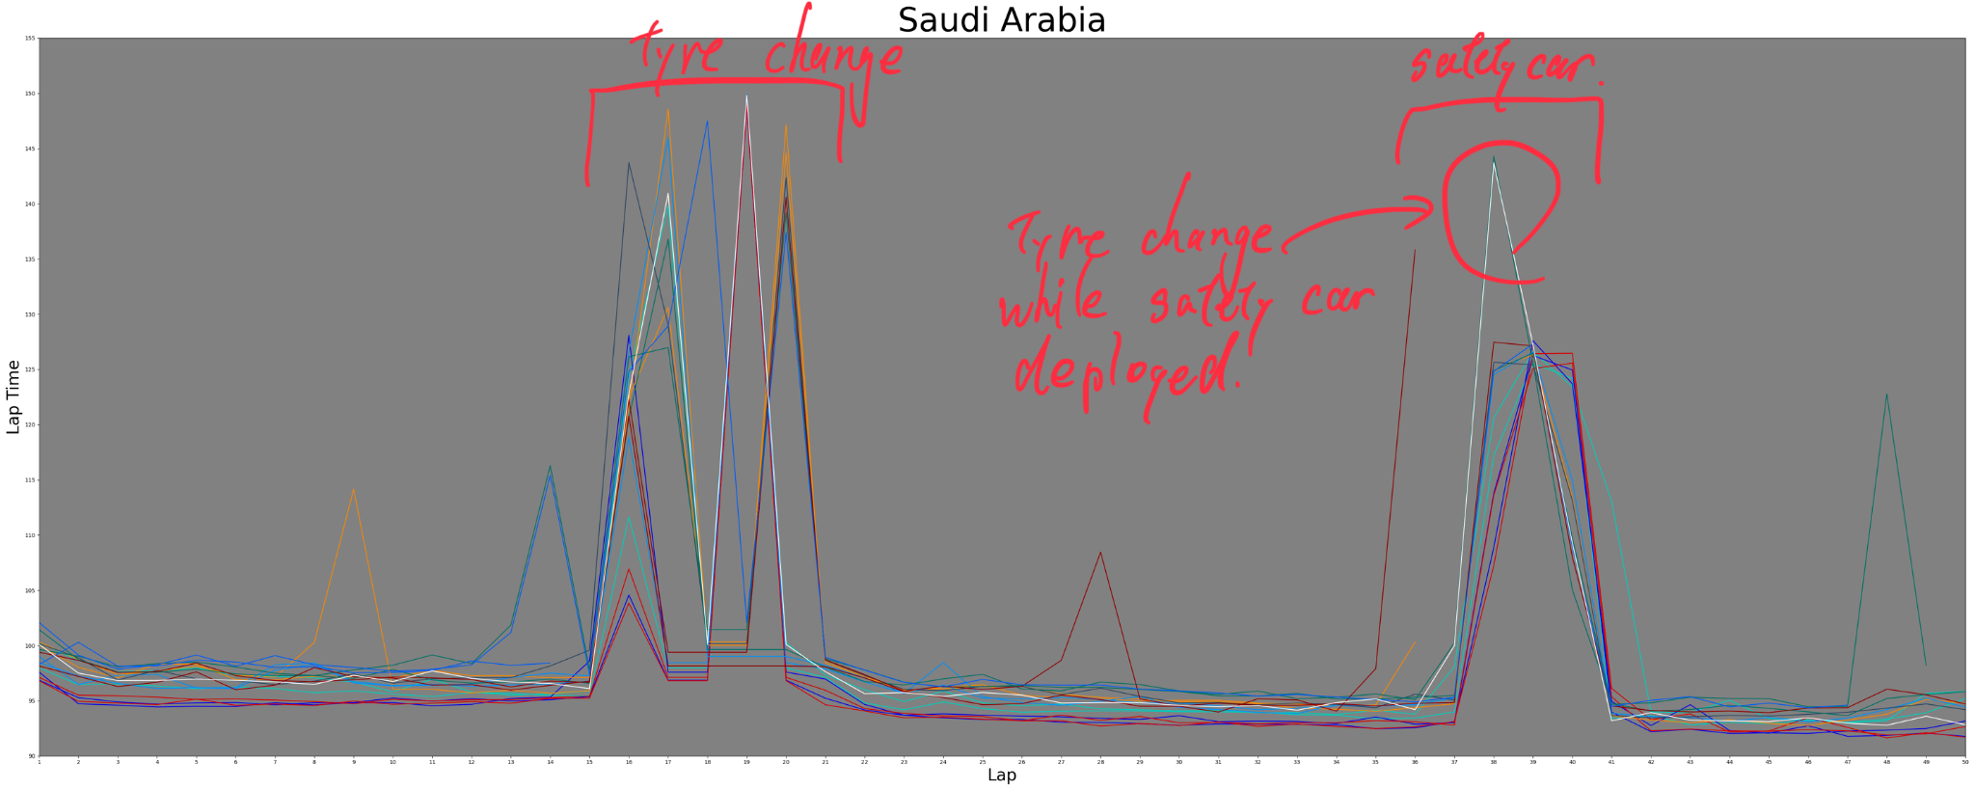
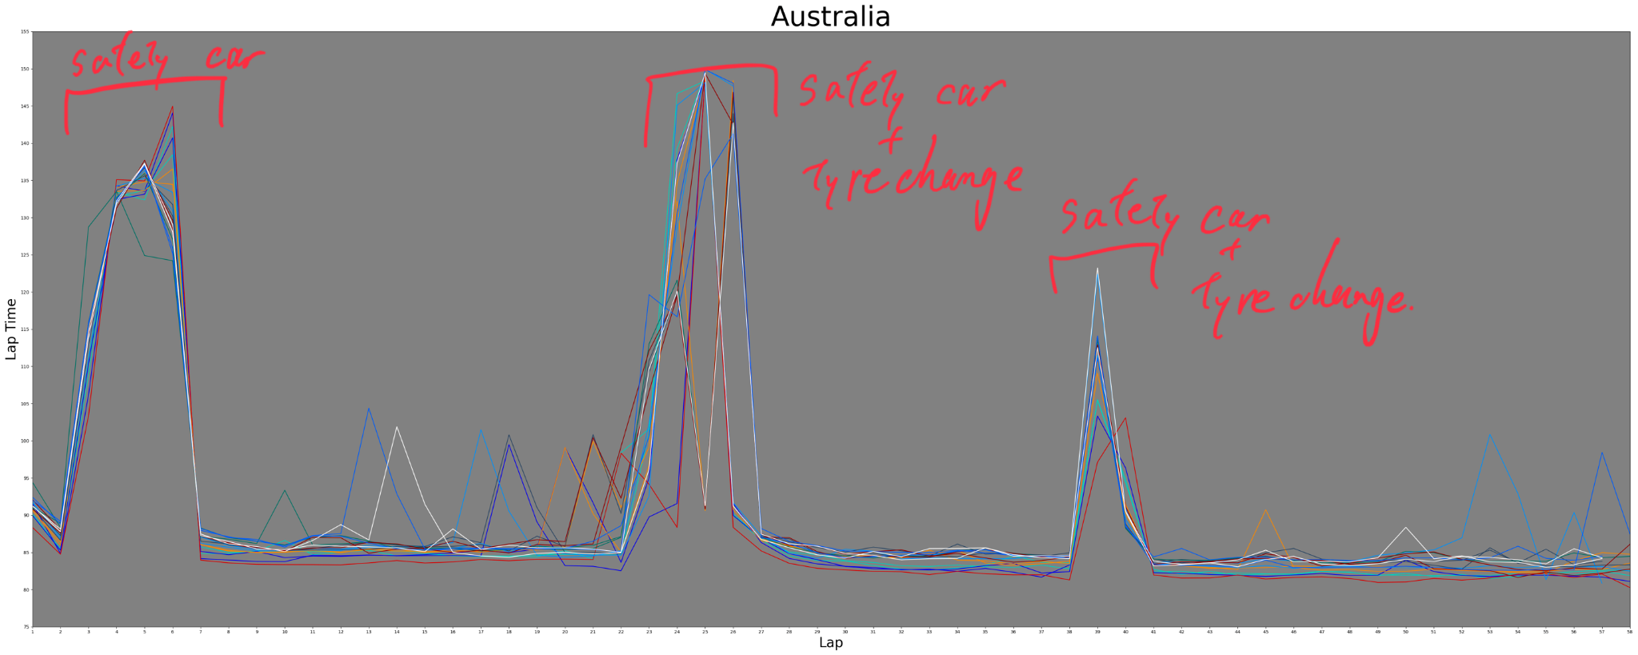
Notes:
#shows race events

Slide 6
Speed
Formula 1 race track is usually divided into 3 sectors.
The top speed for each sector is provided as well the top speed for the longest straight -> this might be the same data for one of the sector top speeds, but since we took the mean of these data, and the condition is equal for everyone, we just included all the data to analyze.

Slide 7
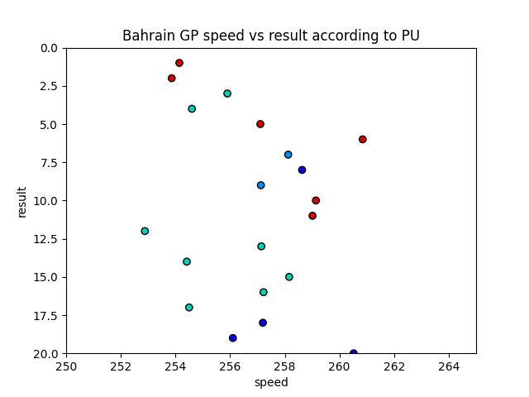
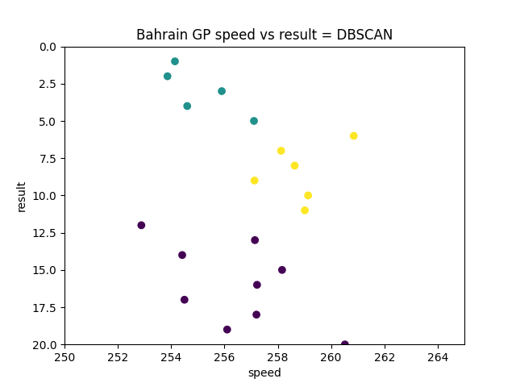
Speed vs result plot for Bahrain race
Notes:
We used the DBSCAN for the plot analysis because the number of clusters was hard to detect. The DBSCAN was done with eps = 3, min_samples = 5. The green and the yellow points are the two clusters and the purple points are the noise. There are only two mercedes cars in the green cluster with the good result, and everyone else is in the noise cluster with the bad result. This result might not be accurate in term of the speed and result correlation because at the end of the race, two red bull cars retired because of the engine trouble. Their mean speeds were very good and running in the top 3 for long time in the race, but they resisted. So the clustering data must have been different if they finished race, and the mercedes car performed more poorly performed.

Slide 8
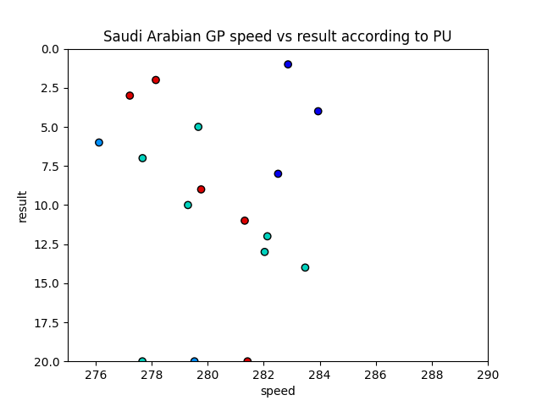
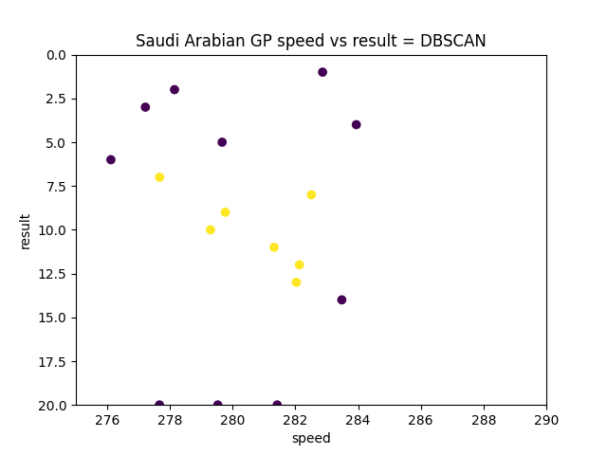
Speed vs result plot for Saudi Arabian race
Notes:
We used the DBSCAN for the plot analysis because the number of clusters was hard to detect. The DBSCAN was done with eps = 3, min_samples = 5. We only see one cluster in this data in the middle, which contains 4 out of 8 mercedes powered cars. This time red bull power trains cars are performing good. However, we clearly see that mercedes cars did not do a great job.

Slide 9
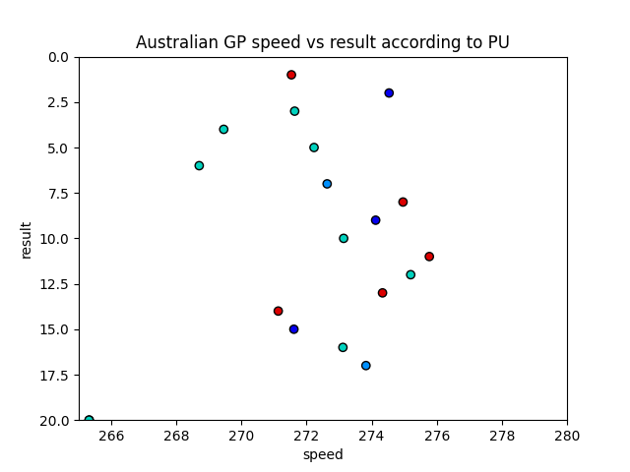
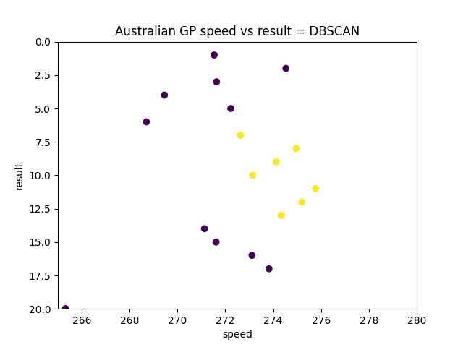
Speed vs result plot for Australian race
Notes:
We used the DBSCAN for the plot analysis because the number of clusters was hard to detect. The DBSCAN was done with eps = 3, min_samples = 5. This time, there is only cluster same as the previous race. However, the mercedes powered cars are performing better than the last time. We see only 3 car in the cluster and the noise with worse result. The noise with better result contains 4 mercedes powered cars.

Slide 10
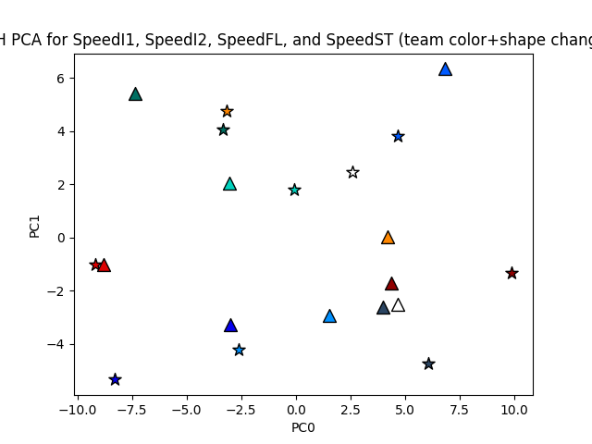
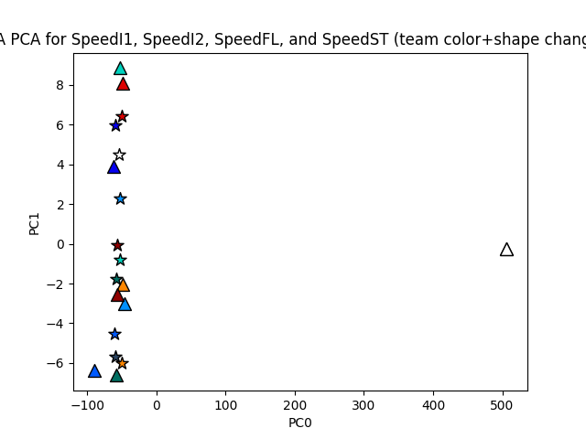
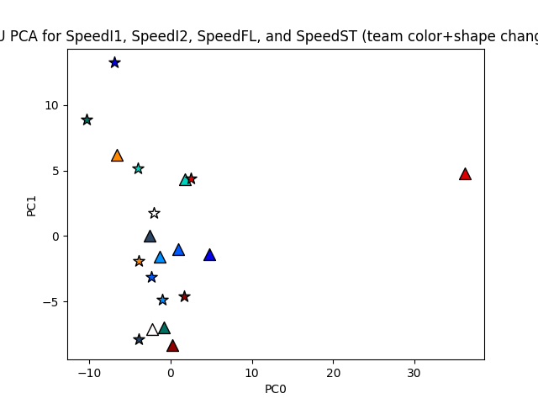
BH: '0.65062', '0.25733', '0.05225', '0.03980'
SA: '0.99862', '0.00080', '0.00047', '0.00011'
AU: '0.63515', '0.26515', '0.06927', '0.03044'
Notes:
Next, we got the PCA of the speed data for 4 speed datas for each car for each race since we wanted to know if we can treat each speeds as the same attribute. The PCA plots are bahrain, saudi arabia and australia from left to right. The variance caught with each principal components were shown in the slide. We plotted the speed in Km/h for each sector and the longest straight and performed the PCA. The PCA for each did not catch the variance well. However, since there is an outlier, the PCA must catch the variance a little bit better. There two car retired the race early in the race before they set a single speed data for the race.

Slide 11
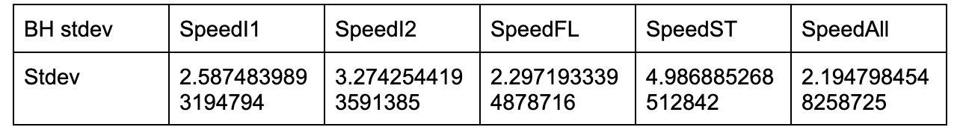
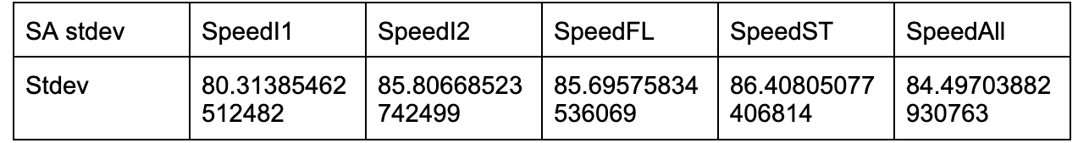
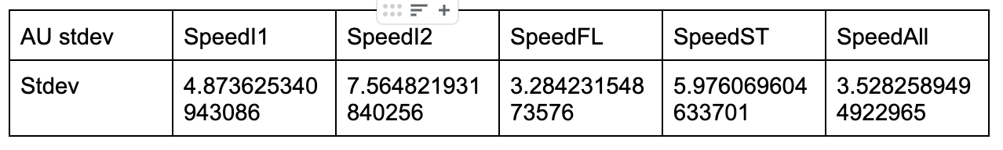
Standard deviation of the speed
Notes:
Next, we took the standard deviation of the speed data to see if there is a huge difference in the speed among the cars. The data says that the deviation of the speed for bahrain and australia are pretty much the same, but since saudi arabia is more a high-speed circuit, the standard deviation is more large for this race.

Slide 12
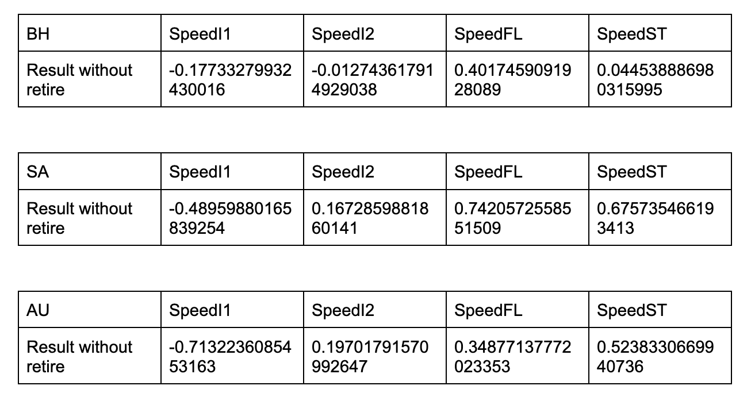
Correlation b/w speed and result
Notes:
We calculated the correlation between each speed data and the race result to see if a speed from a particular sector contributing more on the result. Since the retired cars negatively affects the correlation, we removed the data of the retired cars here. However, we see lots of negative correlation between the speed and result. This is because the modern tracks have a lot corners and the time cars spending in corners is much longer than the time cars spending on the straight. Therefore, moderns formula cars have huge down force to gain the grips to make the cornering time faster. Usually this balance between the cornering time and the straight speed is a trade-off and straight speed is not always the dominating factor of the race pace. Therefore, here, we concluded that top speed on the straight is not a factor of their poor performance in the race.

Slide 13
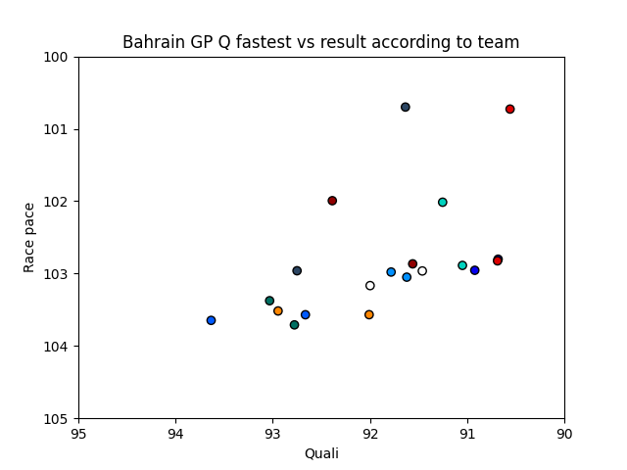
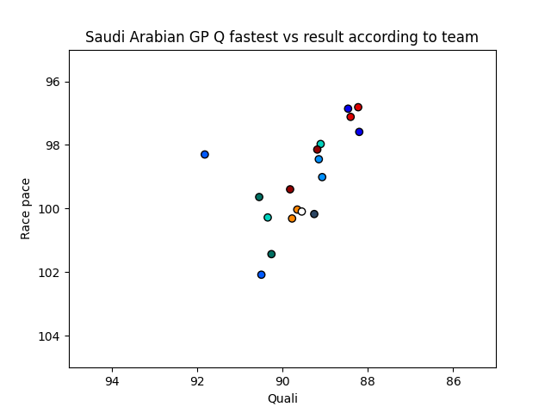
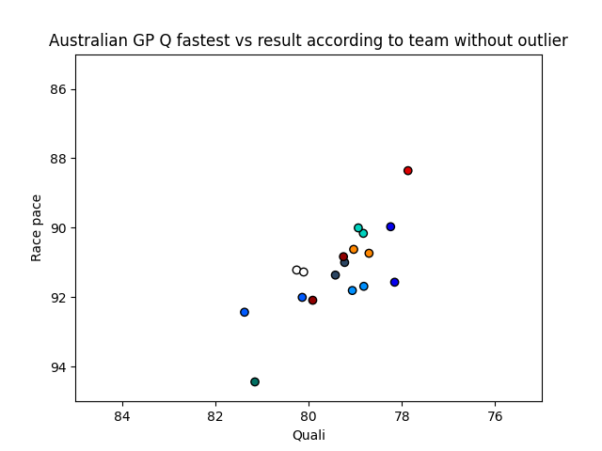
Qualifying fastest time vs race pace
Notes:
Since none of the cars are allowed to change their setting after they started the qualifying session just before the race, we hypothesized that the qualifying session fastest time (which is the potential fastest time for a car) and the race pace is correlated. The qualifying session needs the fastest time for only once, whereas the race pace needs to be fast for long time. However, the plot shows a positive correlation and we could not find any significant result from the plot.

Slide 14
Notes:
When looking back to the first plot, for each race, the tyre changing time is different for each team. For each race, they have 3 different tyres with different grip levels and durability. Tyre strategy is often one of the most important keys in the race. When looking at the lap time plot, the tyre change time is not one specific lap in a race, meaning that some teams are on the different strategy. therefore , we hypothesized that the tyre strategy should be key for the performance.

Slide 15
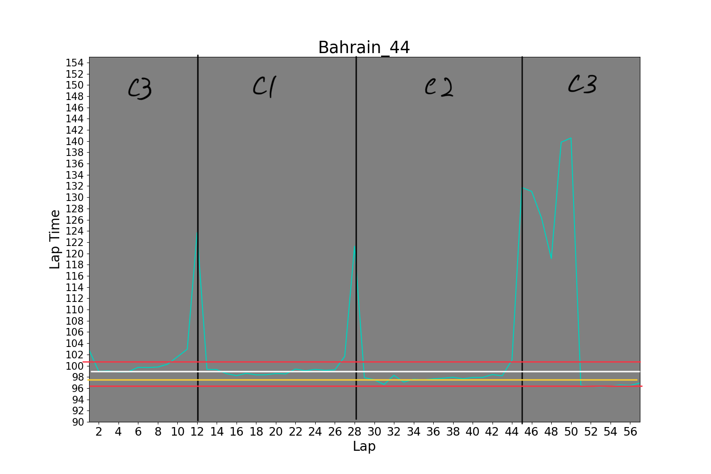
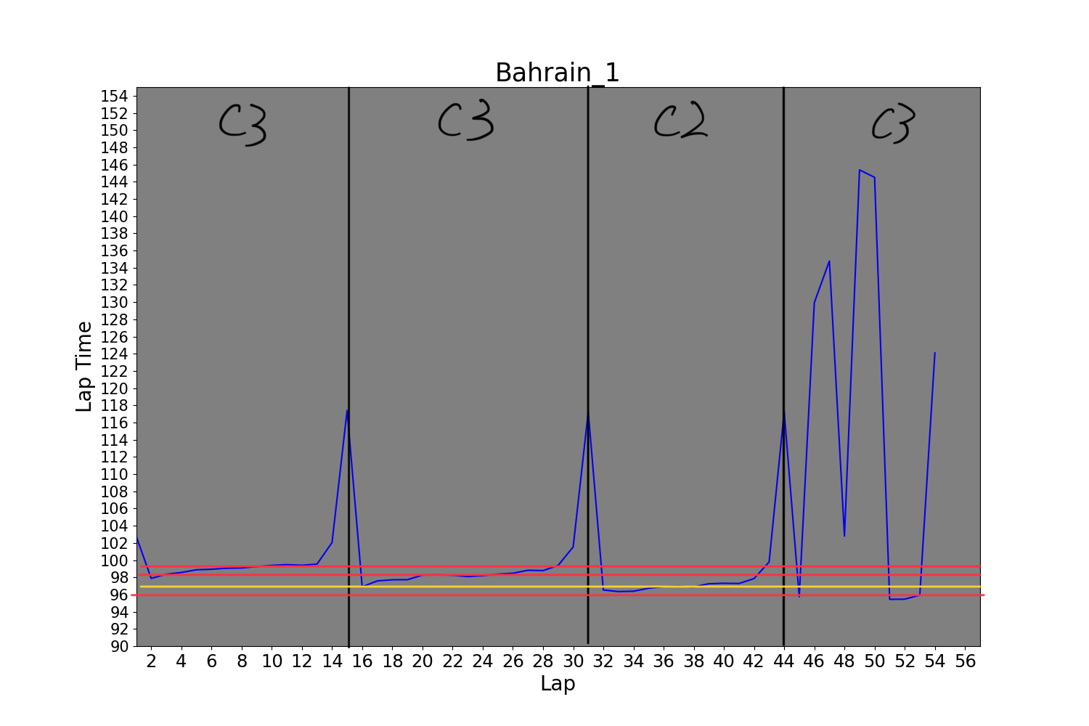
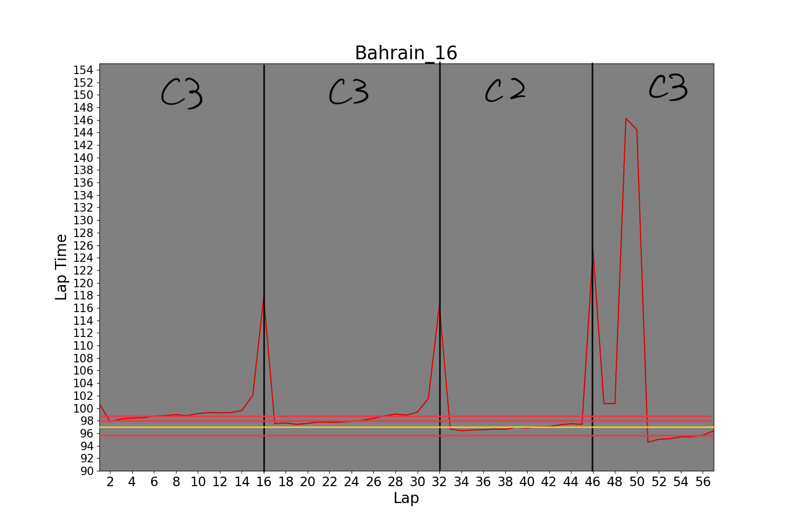
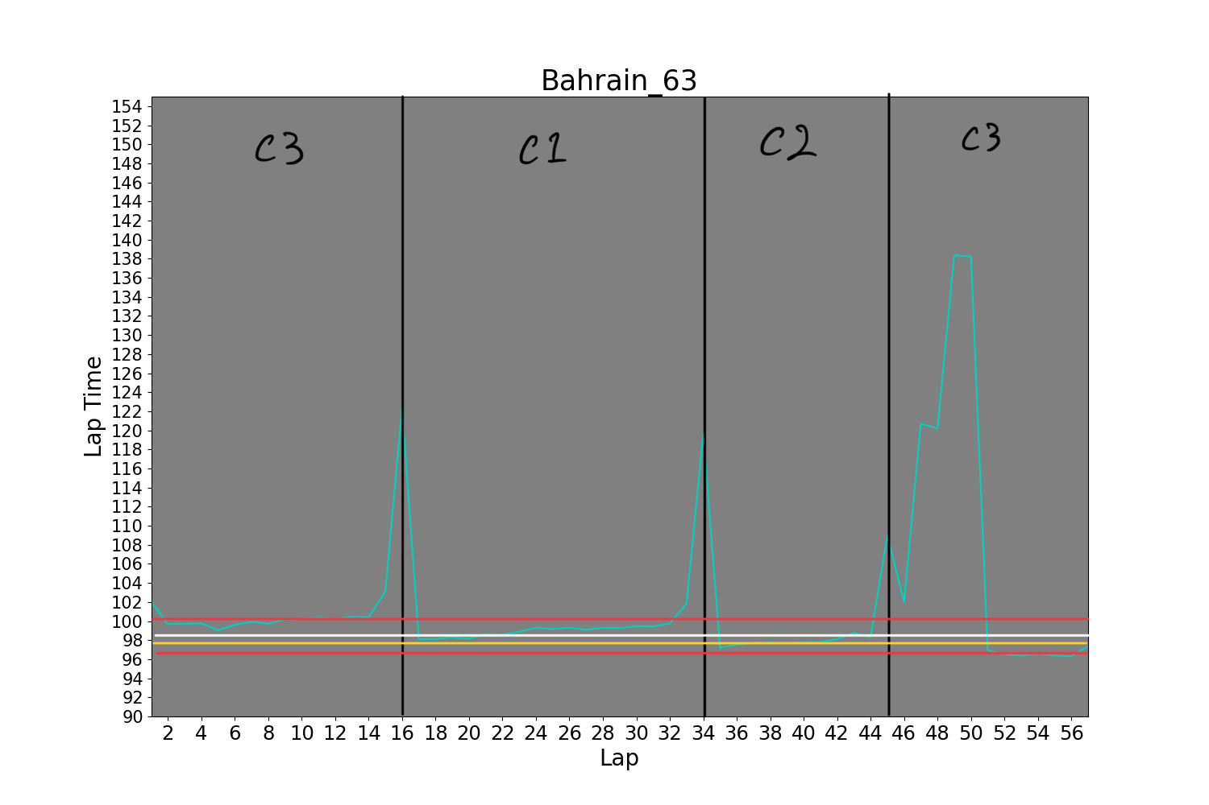
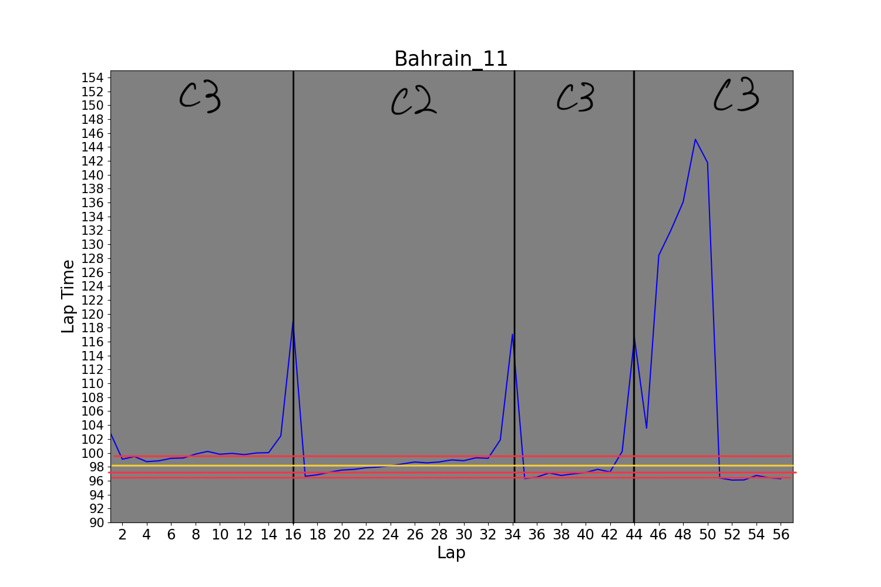
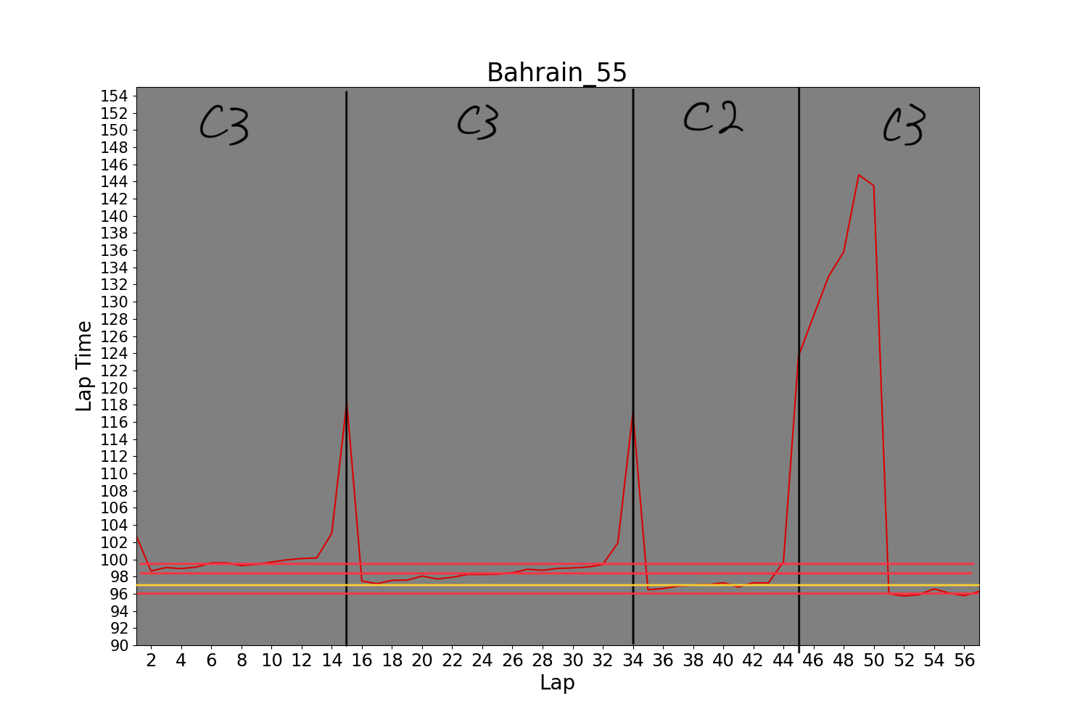
Notes:
C1, C2, and C3 show the type tyres. C1 is the slowest with longest durability and C3 is the fastest with the shortest life. The car number 1, 11, 16 and 55 were dominating the race even car 1 and 11 retired just before the race ended. All these were on the same strategy. However, the mercedes team was on a different strategy. They are the only team that used C1, the slowest tyre.

Slide 16
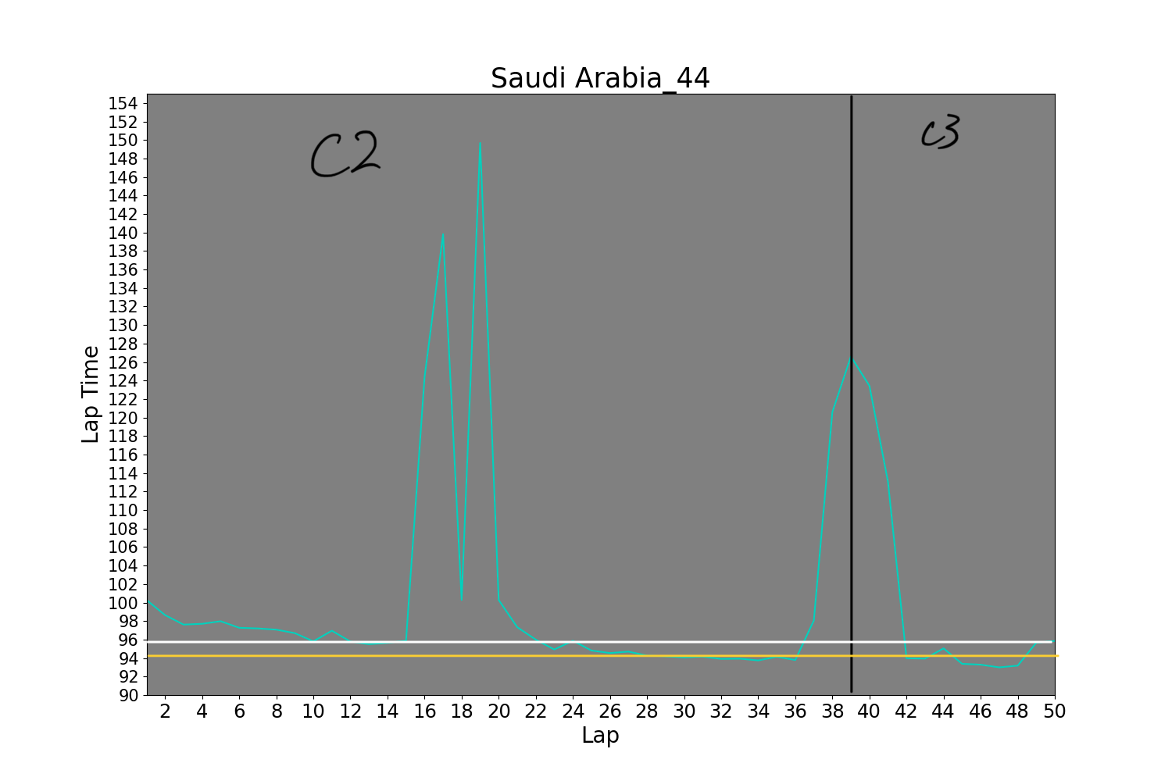
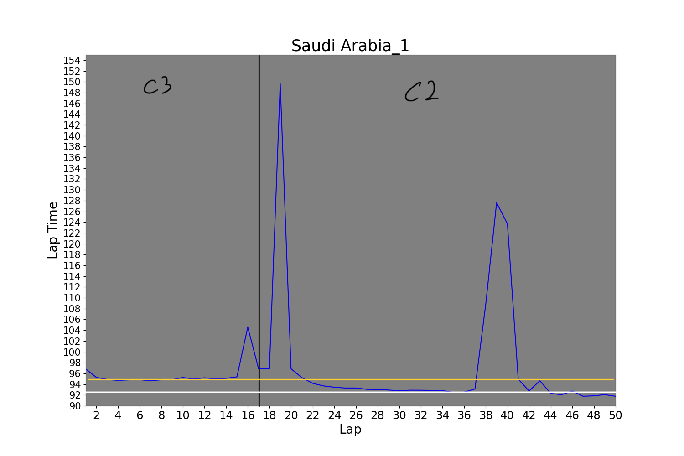
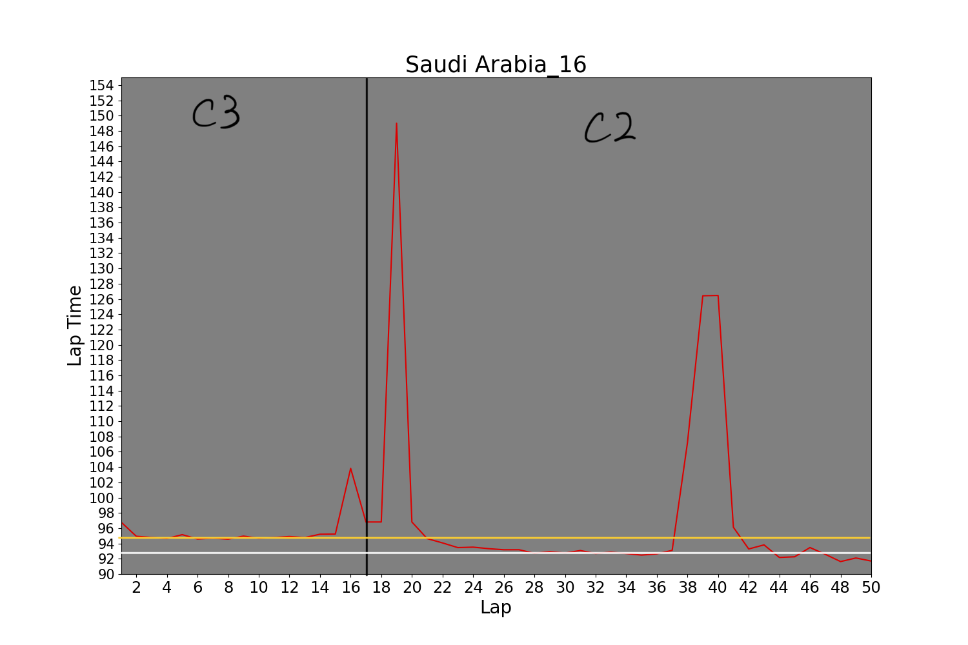
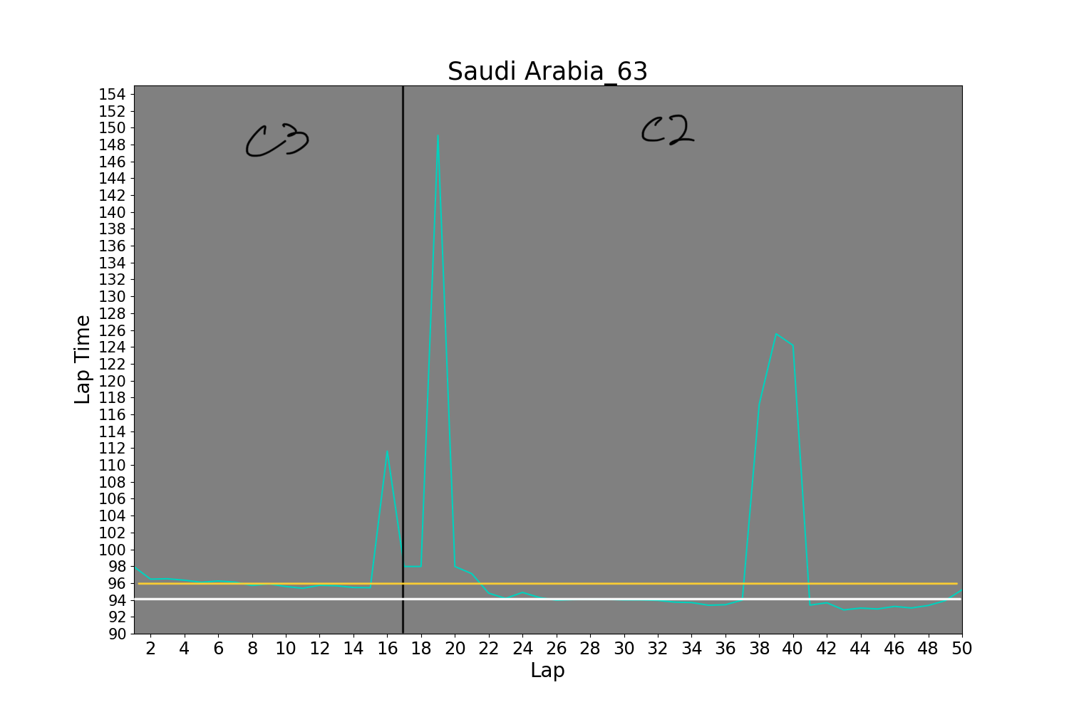
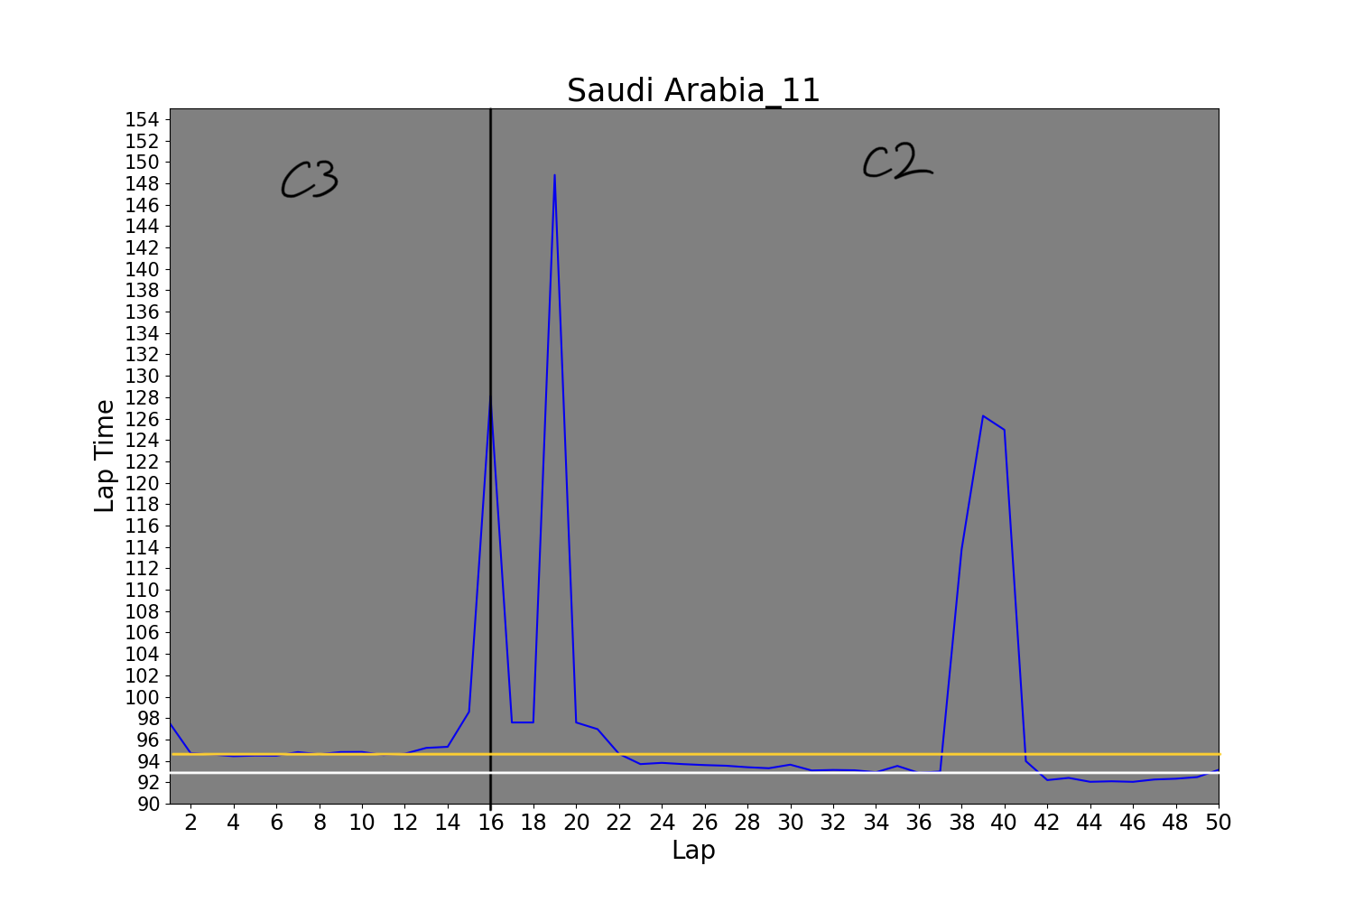
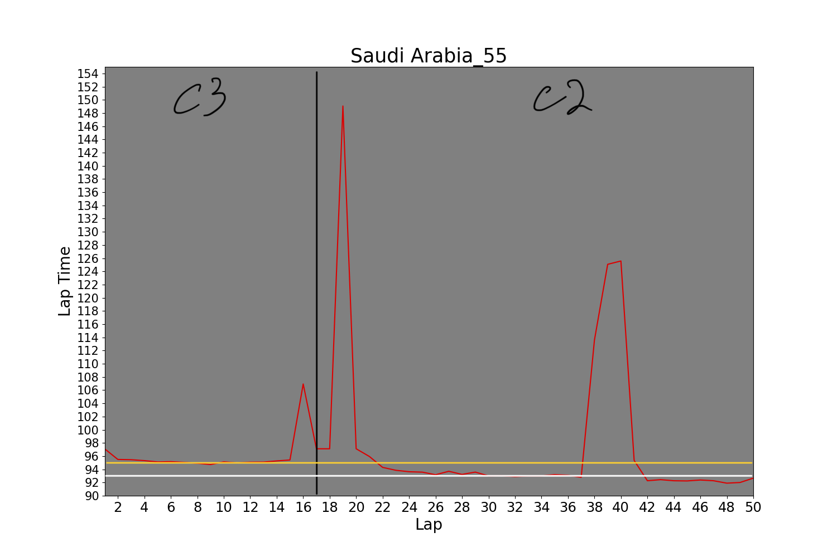
Notes:
In saudi arabian race, car number 1, 11, 16, 55 and 63 followed the same strategy. However, 44 did not. As a matter of fact, these car finished the top 5th, but 44 finished in 10th with a different tyre strategy.

Slide 17
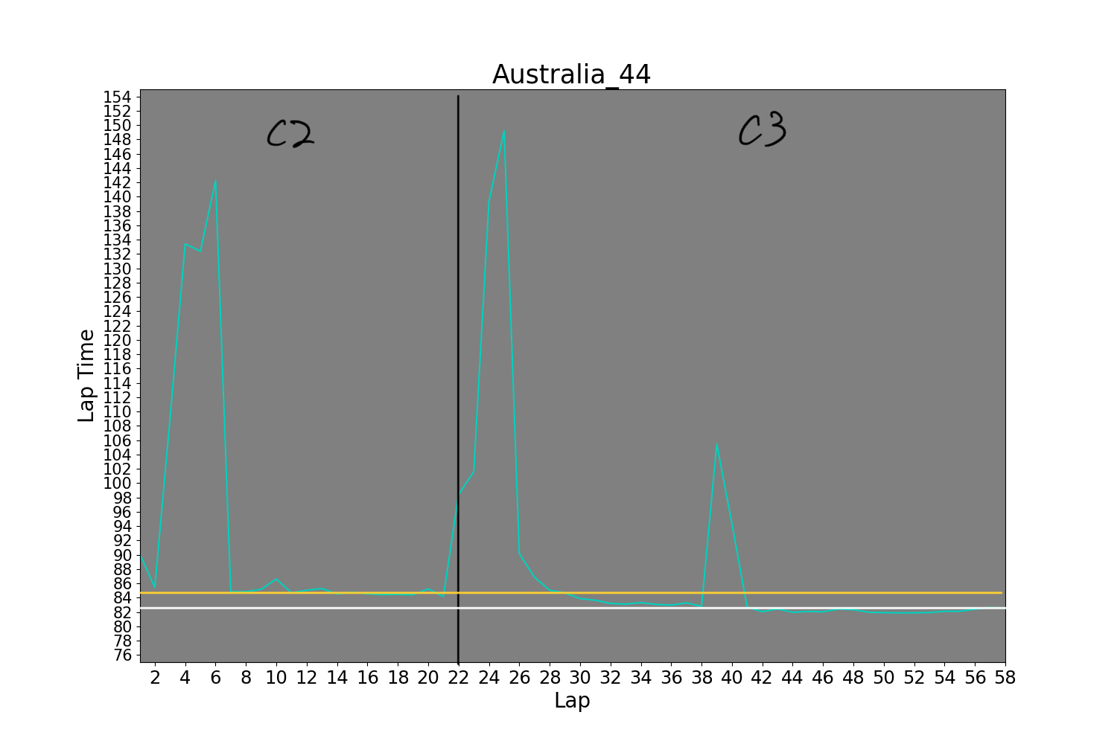
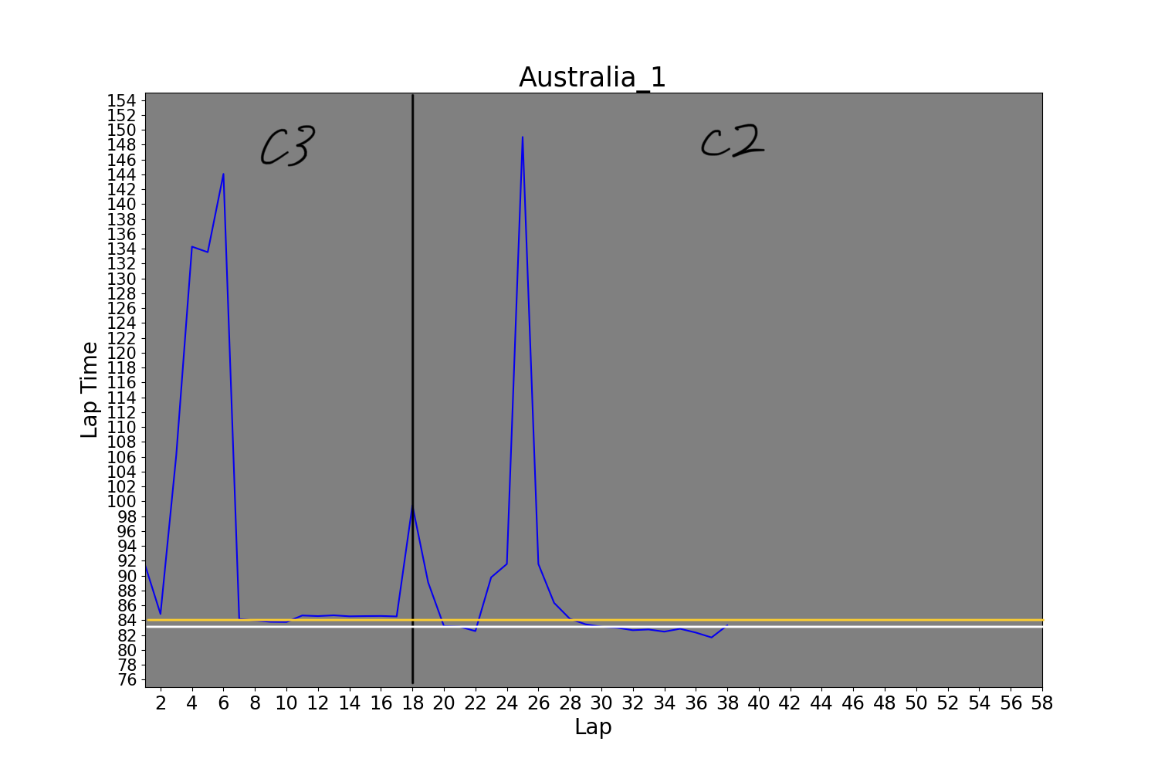
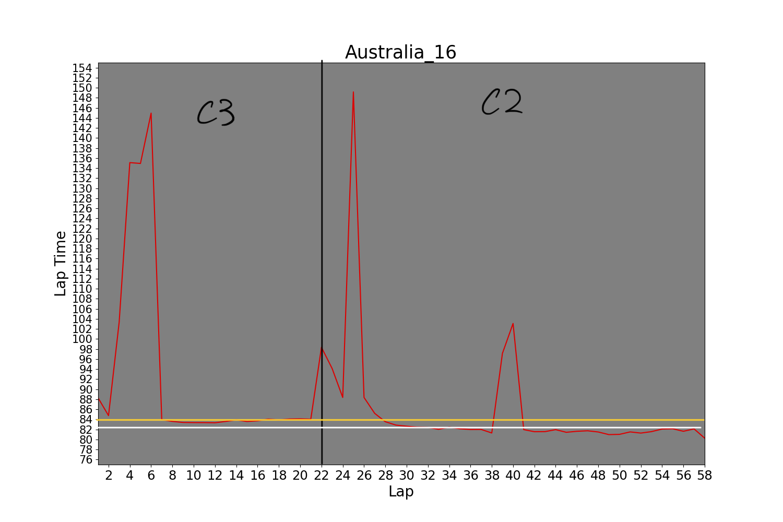
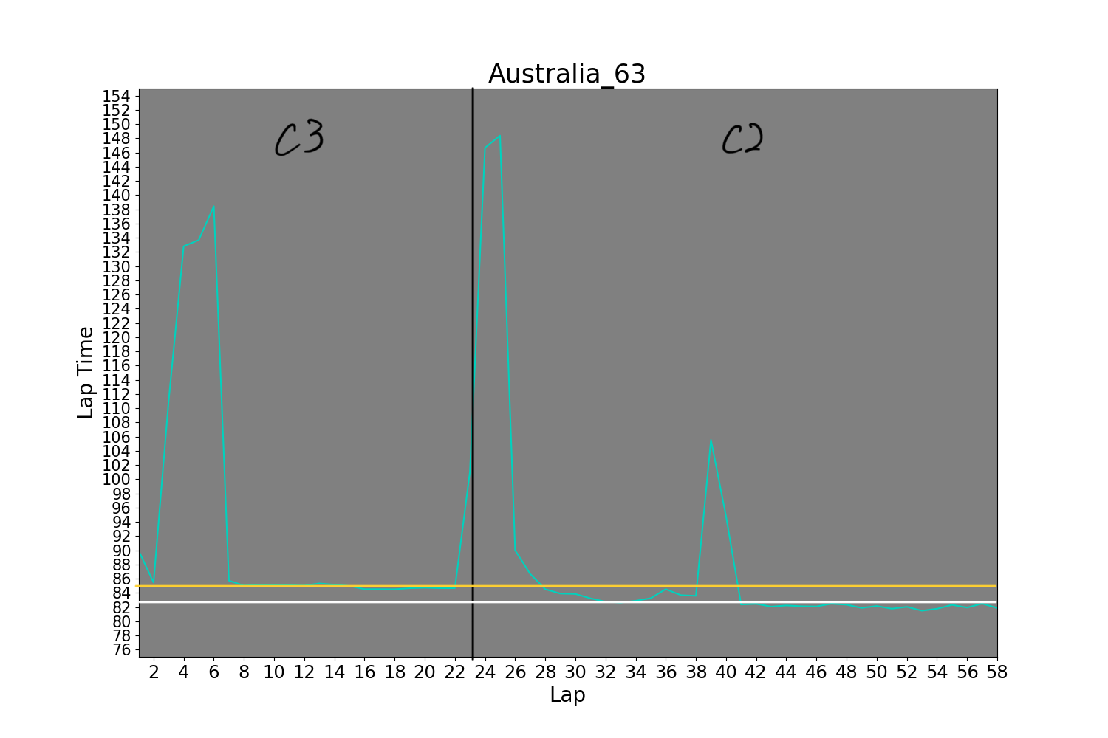
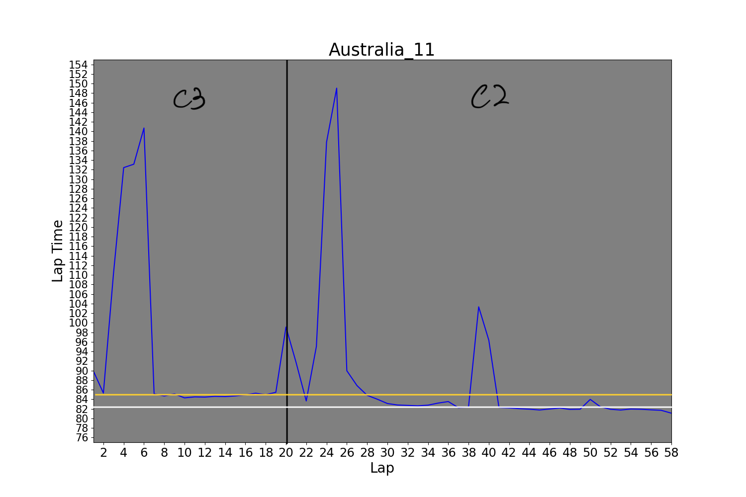
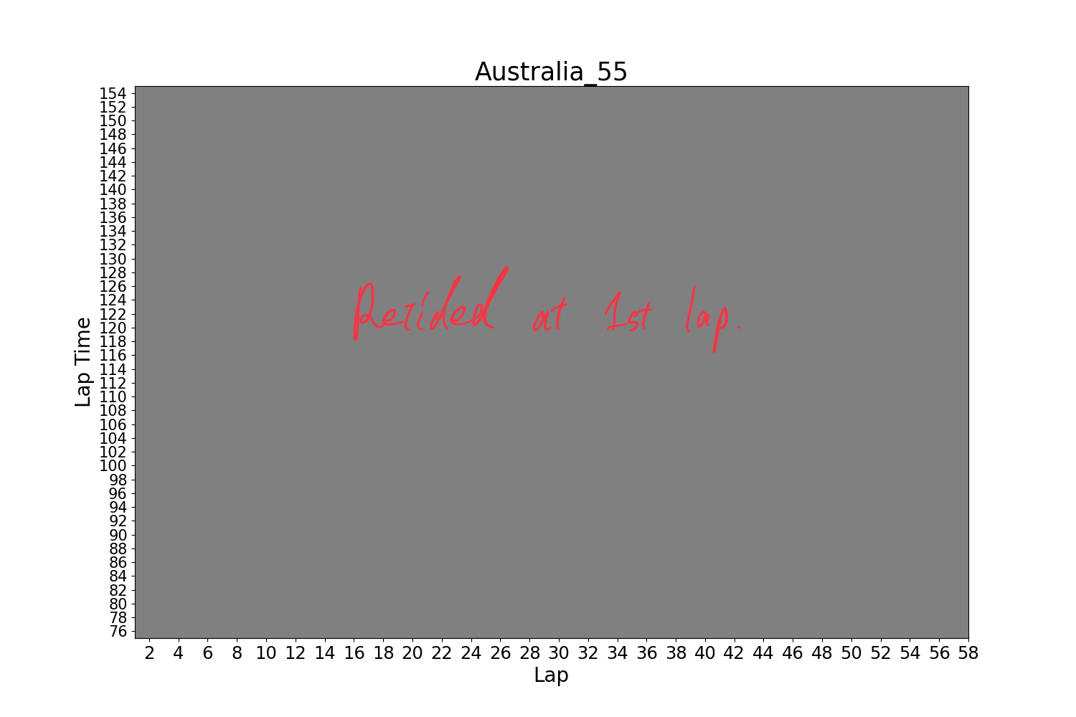

Slide 18
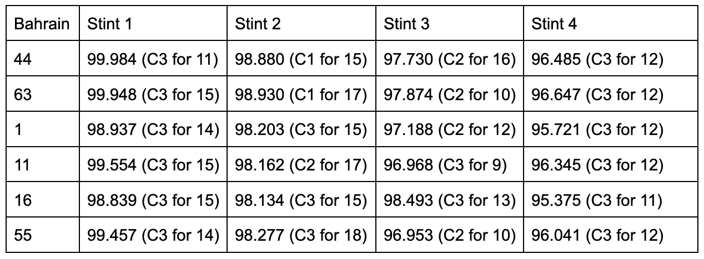
Average stint time for bahrain
Notes:
For this race, car number 44 and 63 were on a different strategy for the stint 2. Their average lap times for stint 2 were 98.880 for 15 laps and 98.930 for 17 laps. Since the lengths of the stint were similar for all of them, 0.796 ~ 0.653 sec of delay for each lap stuck for this stint.

Slide 19
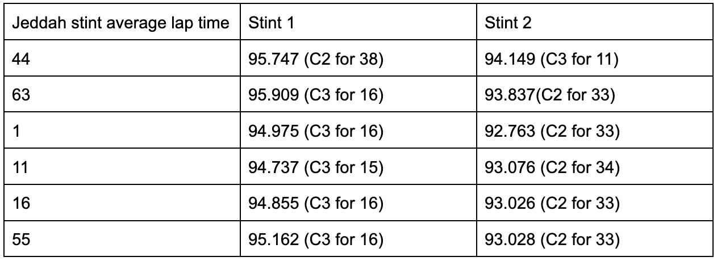
Average stint time for saudi arabian
Notes:
For the saudi arabian race, car number 44 took the different strategy. However, the his first stint average lap time is faster than the ones on the faster tyres. However, everyone else changed the tyre at the same time, which they deployed the safety car for there was an accident at lap 15. On the safety car laps, the cars have to go slower. Therefore, the lap time is slower and the drivers get benefit if they can pit it to change tyre for this time. However, car number 44 missed this time to change the tyre because the pit lane entry was closed for the safety reason. Therefore he lost time when he changed the tyre at lap 45.

Slide 20
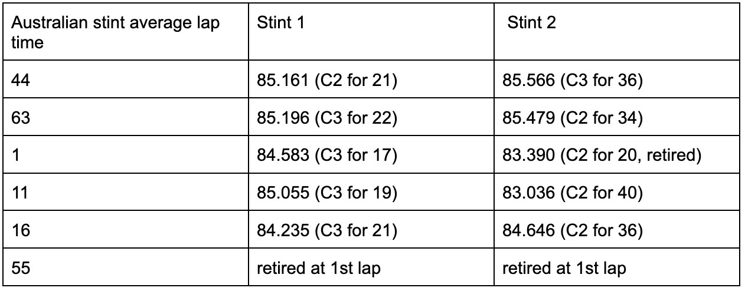
Average stint time for australian
Notes:
For the australian race, only the car number 44 was on the different tyre strategy than everyone else on the table. His first stint was on a slower tyre and second stint was on the fastest tyre. He was supposed to drive a lot more longer on the slower tyre, or the other cars on the faster tyre had to drive for shorter. However, their tyre change timings were not significantly different. Looking at the second stint for car number 44, even though he was on the fastest tyre, he was the slowest of all. This might be because the tyre was gone for quicker than the other cars and he had to drive slower, or the race track was too hot to degrade his tyres a lot quicker and thus the cars on the slower tyre got benefited from being on the more durable tyre.

Slide 21
Discussion
The speed on the track was not a huge different among the top 6 cars that compared in the last part. In the first two races, mercedes team did not perform well in their top speed, but they caught up with the other teams in the third race.
The qualifying session fastest time and the race pace did not show a significant difference. Sometimes, these are trade-off and the fastest cars on the qualifying session can go slower in the race. However, we confirmed the strong correlation between the qualifying result and the race pace for all races.
Lastly, we focused on the tyre strategy for the top 6 cars. Mercedes team tended to have a different strategy than the other two teams. And when they took the different strategy, they perform poorly. Moreover, car number 63 was on the same strategy as the others on the saudi arabian and australian race, and he finished in top 5 for both. However, the car number 44, who drives the same car as 63, was on the different strategy than the car number 63 on saudi arabian and australian race. He did not finish in a good position for these two races as well.

Slide 22
Conclusion
Hereby, we concluded that speed nor the qualifying session pace were not different for mercedes team and it did not affect the race result significantly. We concluded that it was the tyre strategy that made a huge impact on their race result. This is especially clear when compare the average lap time analysis for each stint of the australian race.

Slide 23
What we would do if we had more time
First we would compare the 2022 formula 1 data to previous years.
Next if we had more time we could dive into more specific data, like how fast/slow each turn is taken and seeing if there are certain turns that give a harder time than others, or data on the car specific aerodynamics and if that has any major impact on speed and handling. Another data point we would try to create is to create graphs on rpm and horsepower and compare it to other factors.
Another technique we would implement is a line of best fit to better interpret the data.
Finally we would wait until the end of the current season to implement data analysis on the final races.

Slide 24
Works cited
https://www.reddit.com/r/formula1/comments/lfpyfp/f1_2021_team_colors_hex_codes/
https://theoehrly.github.io/Fast-F1/

